Slide 1
Software Engineering Project / MAIA Master
Group:
Antoine Merlet, Gülnur Ungan, Mladen Rakic, Marcio Rockenbach
Professors:
Dr. Yohan Fougerolle, Dr. Cansen Jiang, Dr. David Strubel

Slide 2
Table of Contents
Introduction
Choices / Target
Project Management
Results
Future Work
Conclusion
Statistics

Slide 3
Introduction
Context
Current state

Slide 4
Choices / Target
Organization of the code
Interfacing
Documentation
Variety of choices
GUI

Slide 5
Project management
Weekly meeting
Tasks splitting:
Sensor
GUI
Mahematics
Software Design & Team Leading
Collaborative tools

Slide 6
Software design
Code splitted meaningfully
Use of UML diagrams for:
Understanding
Documenting
Implementing

Slide 7
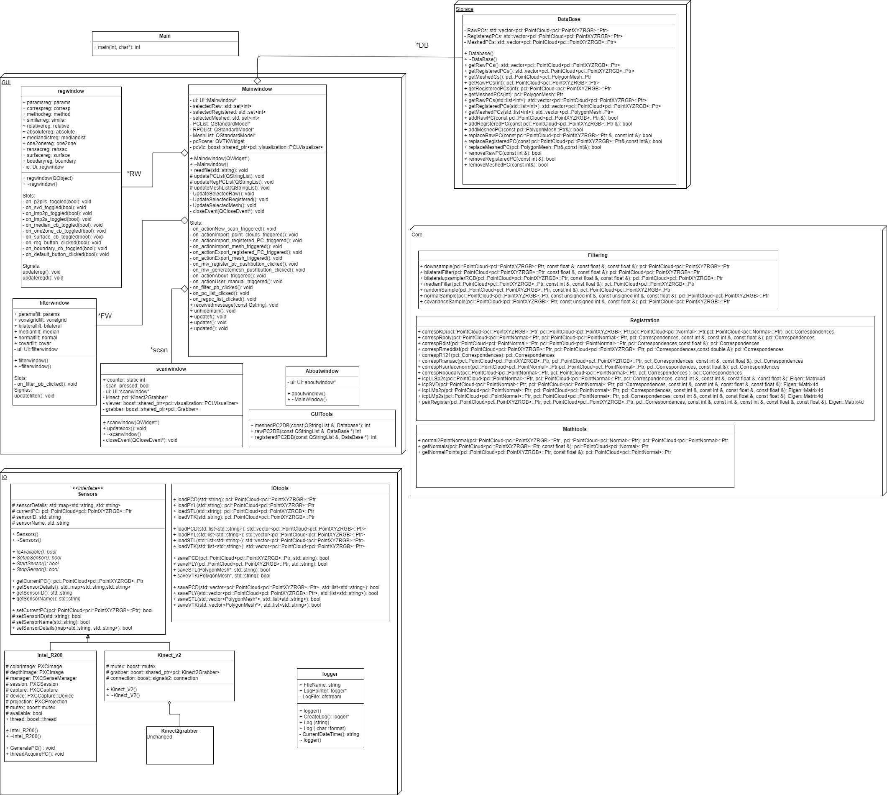

Slide 8
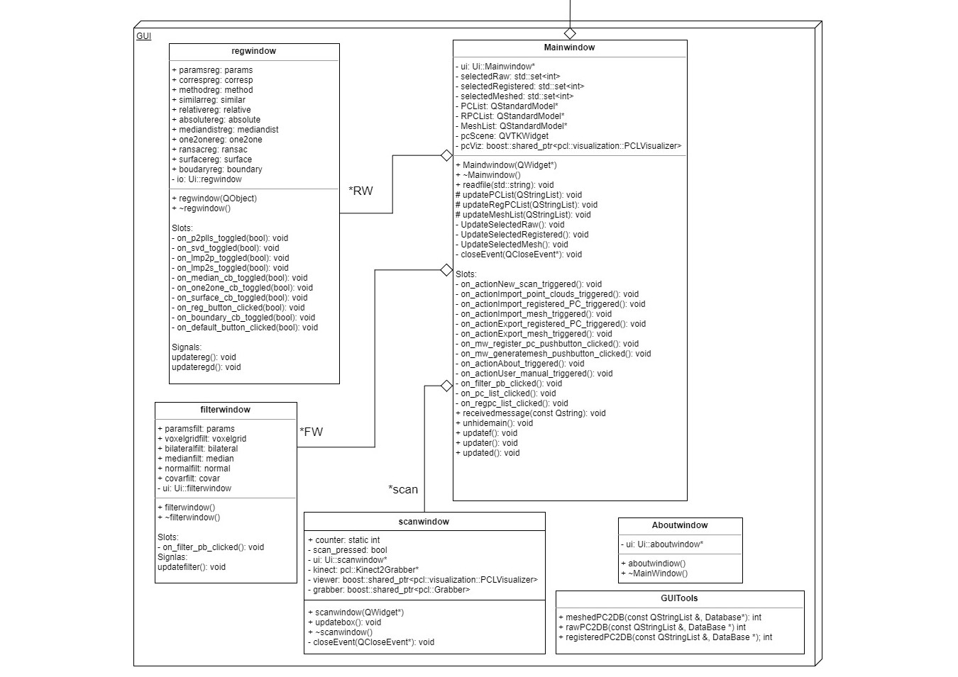

Slide 9
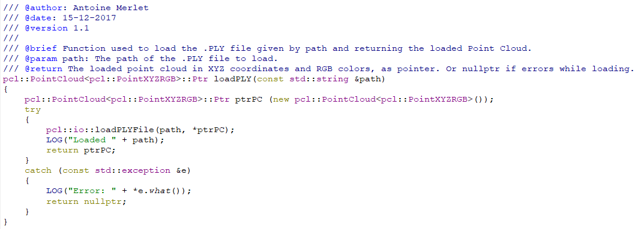
Coding habits

Slide 10

Filtering
6 filtering techniques
Noise Removal
Sampling
Normal Estimation

Slide 11
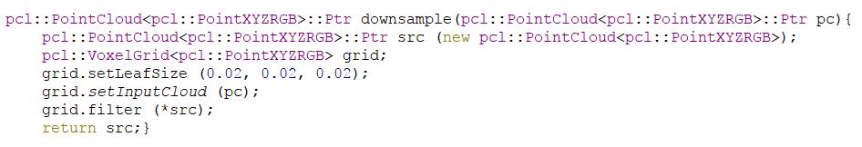
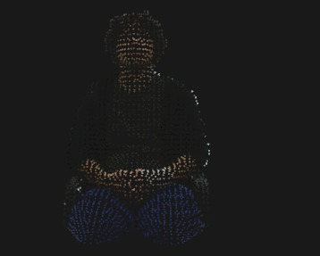
1-Voxel Grid
Based on the input space sampling using a grid of 3D voxels to reduce the number of points.

Slide 12
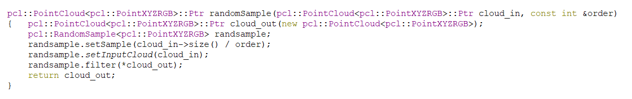
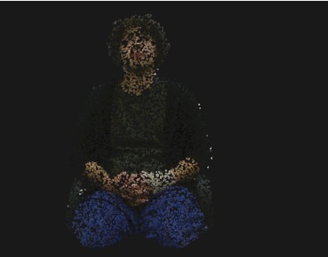
2-Random Sampling
Advantage =force to choose different pairs at each iteration
1 Parameter= Sampling Ratio
Example: S.R=5

Slide 13
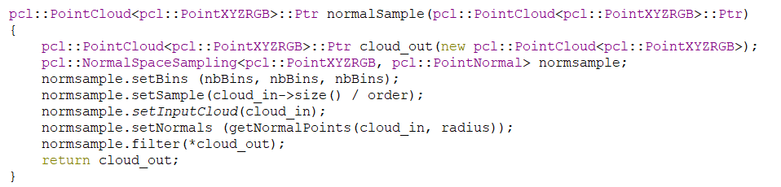
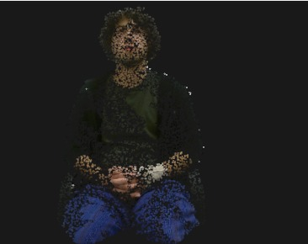
3-Normal Sampling
2 Parameters
Sampling Ratio= 5
Number of Bins= 8

Slide 14
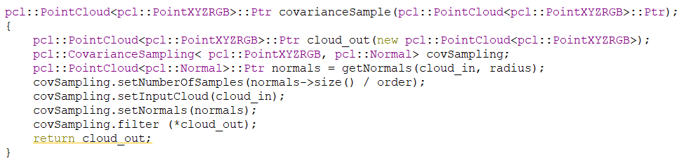
Need to set logical parameters
4-Bilateral Filter: Smooths the signal and preserves strong edges.
2 Parameters:
Sigma S= The size of the Gaussian bilateral lter window to use.
Sigma R= The standard deviation of the Gaussian for the intensity dierence.
5-Covariance Sampling: It selects the points such that the resulting cloud is as stable as possible for being registered (against a copy of itself) with ICP.

Slide 15
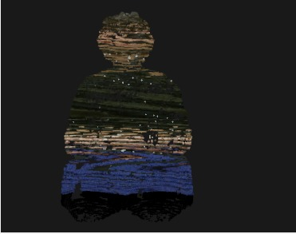
6-Median Filtering. . .

Slide 16
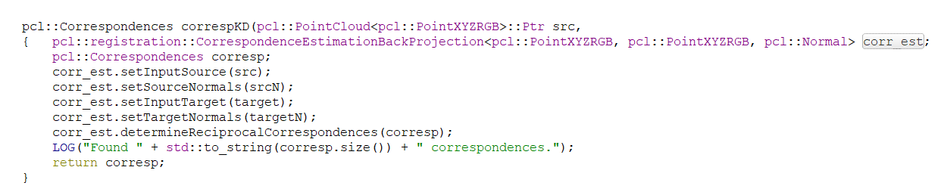
Correspondences
Correspondence estimation :

Slide 17
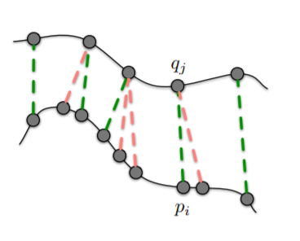
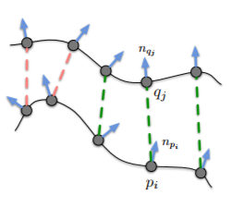
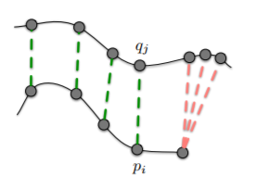
Correspondence Rejection
1 to 1
Organized Boundry
Ransac
Surface Normal

Slide 18
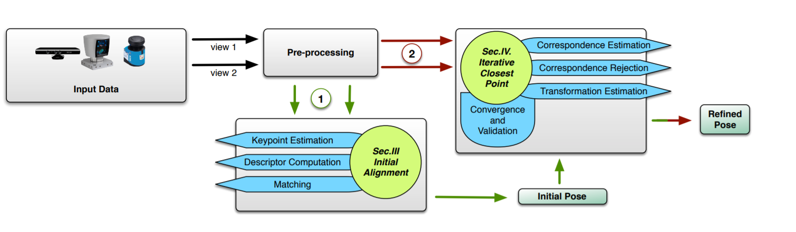
Transformation Estimation
Several possibilities:
SVD
LM Point to Point
LM Point to Surface
Point to Surface LLS

Slide 19
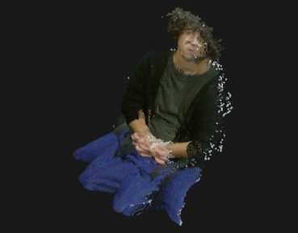
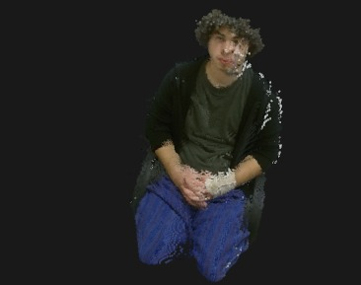
Transformation Estimation
But for now:
PCL ICP (SVD)

Slide 20
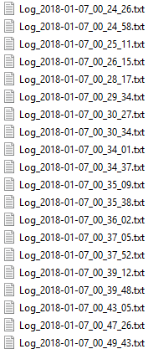

Logger
Debug feature
Singleton design
Signal / slots
Easiness of use

Slide 21
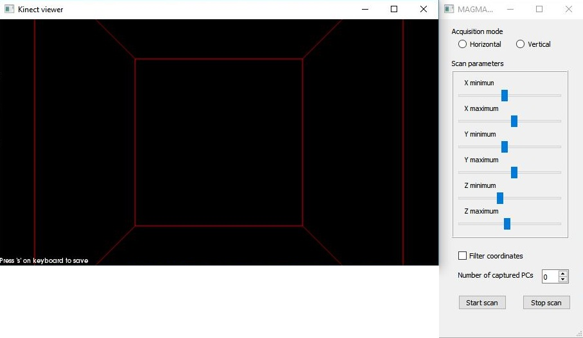
Input / Output
Kinect2grabber
Callback function to keyboard
Bounding box
Live Scan on PCL Visualizer Widget

Slide 22
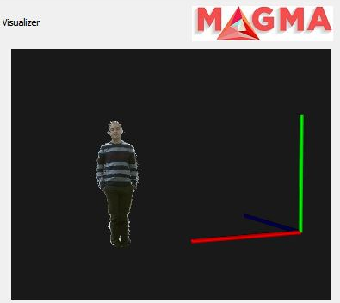
Input / Output
Point cloud display on VTK Widget
Displays raw point clouds, registered PCs and mesh

Slide 23
GUI
Simplicity
Power
Diversity
Organization
Main window
Scan window
Filter window
Register window

Slide 24
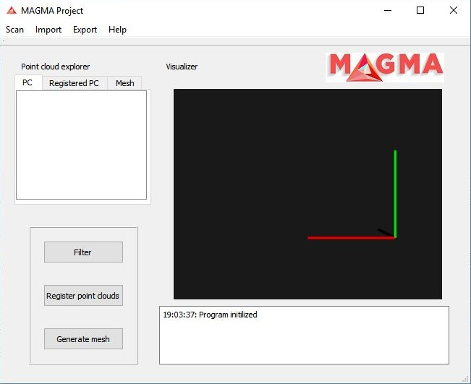
GUI – Main window

Slide 25
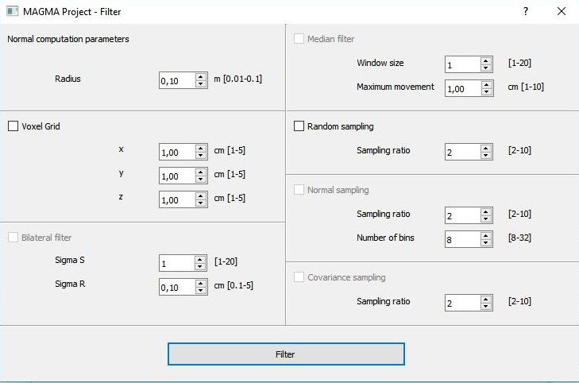
GUI – Filtering window

Slide 26
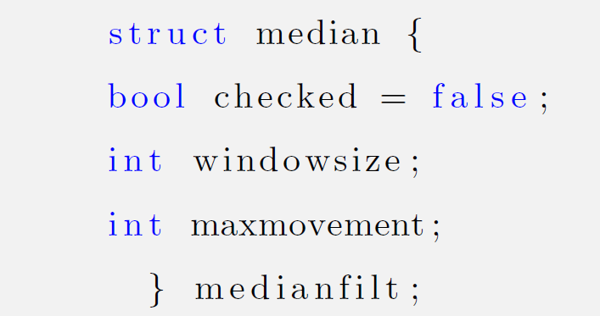
GUI – Example

Slide 27
Results
One folder installation
Deployed software
Logger
GUI Friendly
Good documentation
Interfacing
Readable code
Working filters
Correspondence basics
Bounding box

Slide 28
Future Work
Meshing
Good parameters
Redirect std::cout to logger
Horizontal / Vertical acquisition modes
Configuration files
Full screen application
Functional bounding box
Integrate capture -> display point clouds
SQL database

Slide 29
Conclusion
Challenging Project
Focus:
- Perfect Software
+ Project design and coding habits
Results achieved
Good starting point for next year’s students

Slide 30
Thank you!

Slide 31
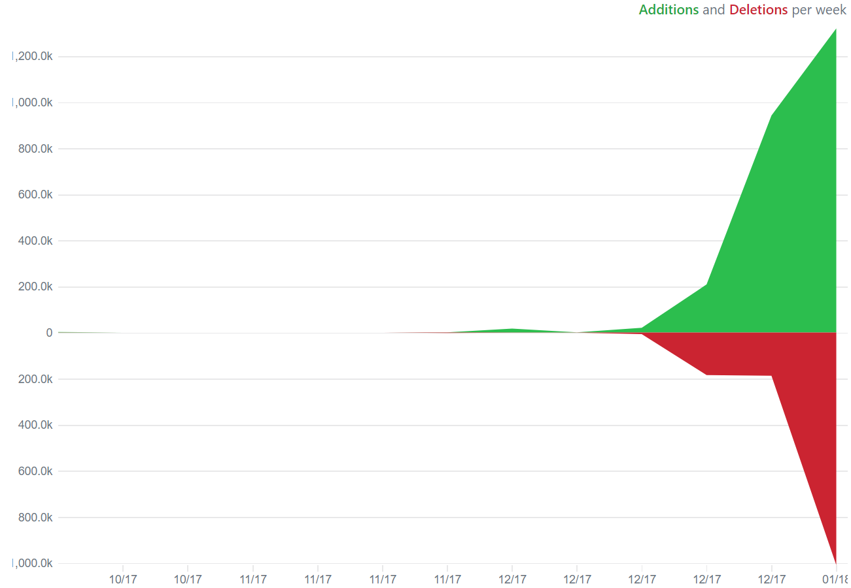
Q & A … and some Stats
Log files created in the last 2 days: 700
Commits: 165
Lines of code: 3748

